Slide 1
Computer Science: What, and Why?

Slide 2

What is Computer Science?
Problem Solving using Computers
Many areas of CS:
Machine Learning and Artificial Intelligence (AI)
Data Science, Big Data
Theory and Algorithms
Programming Languages
Scientific Computing
Systems, Networking, and Databases
Security
Graphics
Architecture
Robotics
Computational Biology
Quantum Computing
Human Computer Interfacing
…
It’s not just programming!

Slide 3
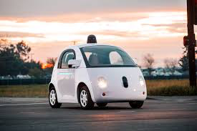
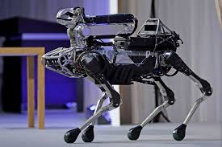
What is CS Used For?
Computers, Mobile Phones, etc.
Word processing, spreadsheets, etc.
Computer games, computer animation
Self-driving cars and trucks, robots, …
The “Web”
Apps and “The Cloud”
Google Search, Facebook, WhatsApp, Instagram, ...
Uber, Amazon, eBay, …
Blockchains and Cryptocurrencies
Smart home, smart farm, smart city, …
Air Traffic Control, Power Grid, etc.
Modern health care
much much more
What are your favorite computer apps?

Slide 4
Career Paths in CS
Become a programmer
specialize in robots, computer games, or …
Become a web designer
build nice web sites
Become a data analyst
collect data and figure out what it means
Become a systems/network/database administrator
maintains systems, email, computer networks, etc.
Become an entrepreneur
start a company (consulting, new tech, etc.)
Become a professor
come up with new uses for computers, and teach students about computer science
…

Slide 5
There are many high paying CS jobs out there!!
Almost every industry needs CS experts
International opportunities

Slide 6
My Career Path in CS
I was born and grew up in Amsterdam
I liked building electronic stuff in high school
even built some small computers
Studied mathematics in university
but quickly specialized in programming
Became a “Research Assistant” to a computer science professor
Became a Ph.D. student
After my degree, I did a “postdoctorate” at Cornell University in the United States

Slide 7
Career cont’d
I worked for AT&T Bell Labs in 1990
Started a research position at Cornell in 1991
Co-founded two software development companies in late nineties
One sold to Microsoft, other to Amazon
Started another company last year with Prof. Weatherspoon
Also still a professor at Cornell

Slide 8
Cornell: A Special View
Originally: Focus on qualitative innovations:
Hardware was getting faster, and qualitative properties only became more important
Subsequently: Add researchers who also engineer
Work is still principled; contributions are more about ideas than artifacts.
“Build first” [them] versus “Think first” [us]
Building first to discover the important problems
Building second to validate assumptions and thesis
Notes:
Early asynchronous consensus protocols done here long before Paxos. Famous lower bounds derived and proven here.
First formal characterization of safety and liveness properties. The notion of “fail-stop” failures originates here.

Slide 9
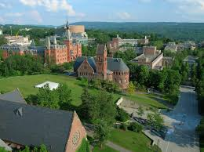
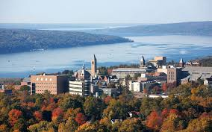
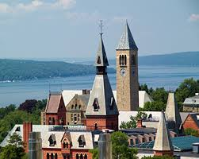
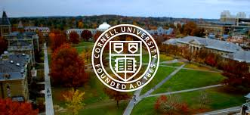
Cornell: very pretty!

Slide 10
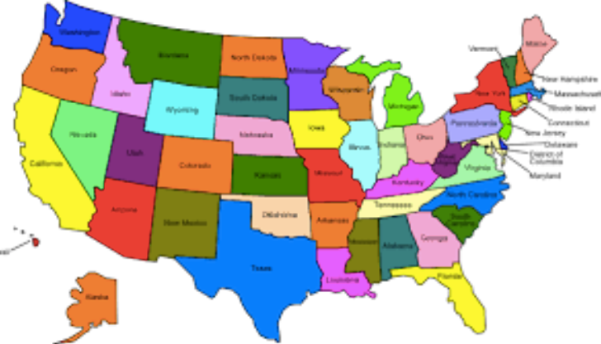
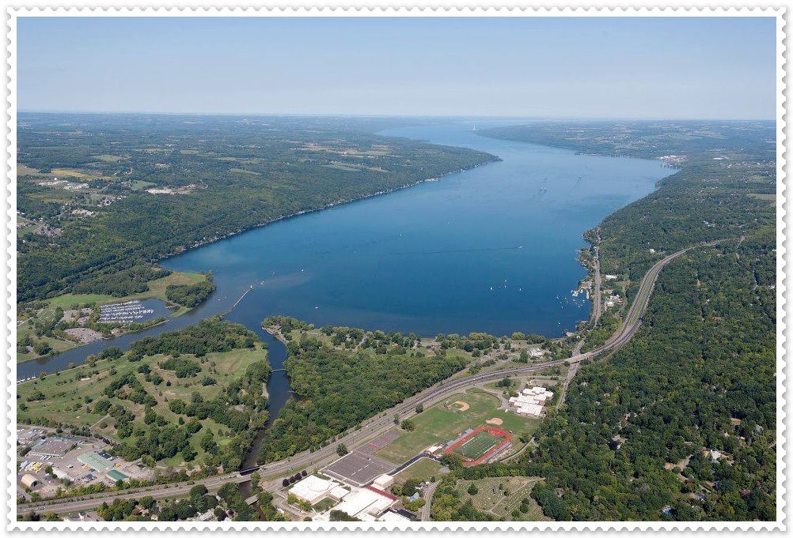
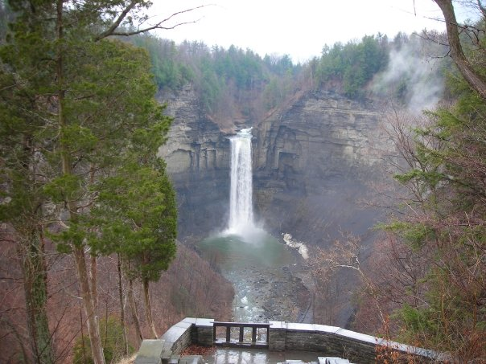
Ithaca
“Centrally Isolated”
4 hours from New York
4 hours from Toronto
3 hours from NIagara Falls
4 hours from Philadelphia
6 hours from Washington D.C.
6 hours from Boston

Slide 11
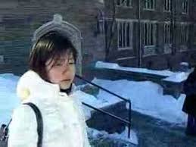
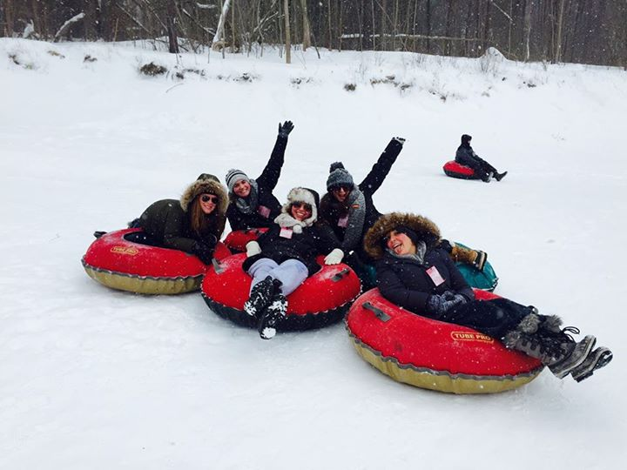
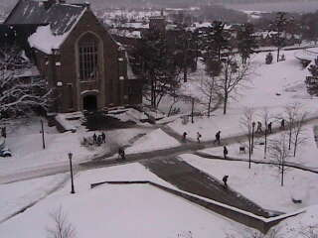
Ithaca Winter
Long and cold
Good for studying
Fun too!
Good for socializing!

Slide 12
Cornell Activities, Clubs, and Classes
sailing
windsurfing
canoeing
kayaking
scuba diving
downhill skiing
cross-country skiing
music
ice skating
rock climbing
hiking
camping
caving
dancing
wine-tasting
…

Slide 13
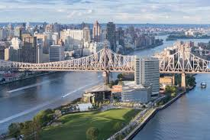
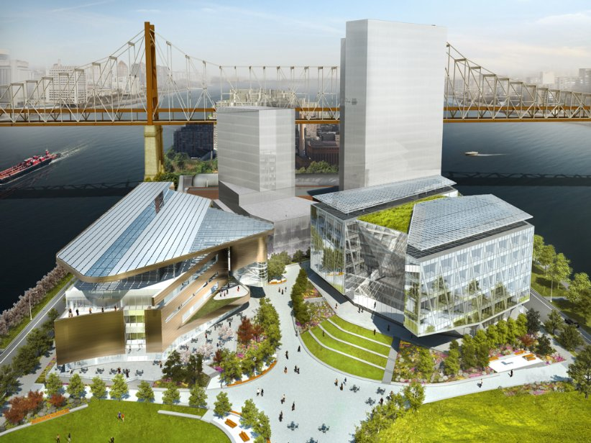
CornellTech in NYC
Silicon Alley
Emphasis on
entrepeneurship

Slide 14
More on Cornell Computer Science
Consistently ranked among top 6 in the U.S.
World-class research covering all of C.S.
About 70 excellent faculty in C.S. “field”
About 150 Ph.D. students in C.S. department
Field includes:
Electrical and Computer Engineering
Information Science
Applied Math
Mathematics,
Operations Research and Industrial Engineering
Mechanical and Aerospace Engineering
Computational Biology

Slide 15
Cornell C.S. areas of research
theory
programming languages
scientific computing
artificial intelligence
machine learning
computer graphics
systems and networking
distributed systems
security
databases
robotics
natural language processing
human computer interfaces
and much much more…

Slide 16
Faculty and Students
Student-to-faculty ratio is about 3:1
Faculty and student offices interspersed
“Central Isolation” is great
faculty has lots of time for students!
Faculty and students socialize, play sports, play music, picnics, holiday parties, …
Friday “TGIF” social hour
Brown Bag Lunch
…

Slide 17
Program Structure
Each year about 30-40 new students join
Year 1: students become familiar with the faculty members and their areas of research by taking graduate courses, attending research seminars, and participating in research projects
Year 2: each student selects a specific area, finds an advisor, and forms a committee based on the student's research interests
Year 3: thesis proposal exam
Year N: thesis defense
Summer Internships

Slide 18
A-Exam and B-exam
Year 3: student presents initial results are presented during a comprehensive oral evaluation, which is administered by the members of the student's Special Committee. The objective is to evaluate a student's ability to undertake original research at the Ph.D. level.
Year N: thesis defense

Slide 19
External Minor Requirement
Cornell offers almost 90 fields, includes
Applied Mathematics
Information Science
Electrical and Computer Engineering
Operations Research
Statistics
Business
Music
Theater
Psychology
Women's Studies
Philosophy
Finance
…

Slide 20
Funding
Each student “in good standing” will be funded by the department
includes tuition, health insurance, and stipend
stipend is $25,152 for nine months
Two semester T.A. requirement
maximum 15 hours per week average
Faculty typically pays for R.A. out of research funding for other semesters
Apply for Fellowships!

Slide 21
Admission
Upload on-line by December 15:
Official transcripts of all previous university work
Statement of purpose
your interests
people you may want to work with
research experience
3 or more letters of recommendation
very important!!
GRE scores
minimum 3.5 average or above
suggested 500-verbal, 750-quantitative, 5.0/6.0 analytical
Proof of competence in English (TOEFL or IELTS)
minimum: 15-listening, 20-reading, 20-writing, 22-speaking
Class Standing: top 5%

Slide 22
What Not To Do
No paid agents, credentials services, or other paid professional assistance
The use of such services violates University policy, and may lead to the rejection of application materials, the revocation of an admissions offer, cancellation of admission, or involuntary withdrawal from the University
Applying directly to faculty
Students are selected by committee

Slide 23
What We Look For
No fixed formula
A coherent body of coursework with a high average grade in the A− to A+ range
Adequate mathematical background
Research experience
Letters of recommendation
An applicant whose record is weaker in some respect (e.g., GRE scores) may be admitted if strength is revealed in some other respect (e.g., exceptional letters of recommendation)

Slide 24
Summary
High impact
Highly collaborative
Well resourced
… an exciting place to be!

Slide 25
Other programs
Top ranked: MIT, Stanford, Berkeley, CMU
Next: Cornell, Princeton, UW, UCSD, …
Next: …
Ranking uses arbitrary formula
Absolute amount of funding, instead of funding / faculty
Ranking isn’t “One Size Fits All”
different schools best for different students
Apply to different levels
“reach” schools
“safety” schools

Slide 26
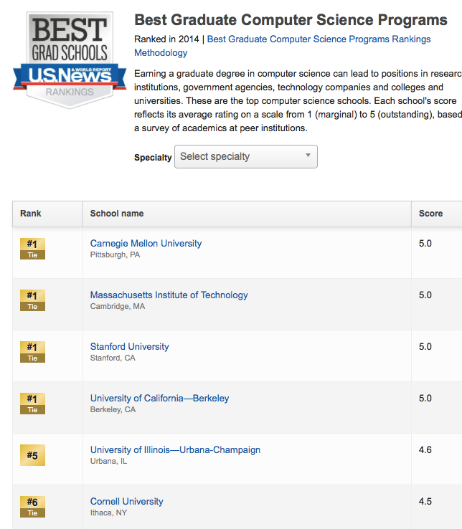

Slide 27
How To Select
Whom would you like to work with?
look for faculty and research web pages
changes very quickly from year to year!
faculty move or retire
new faculty hired
Where would you like to live?
four years is not as long as you think

